Slide 1
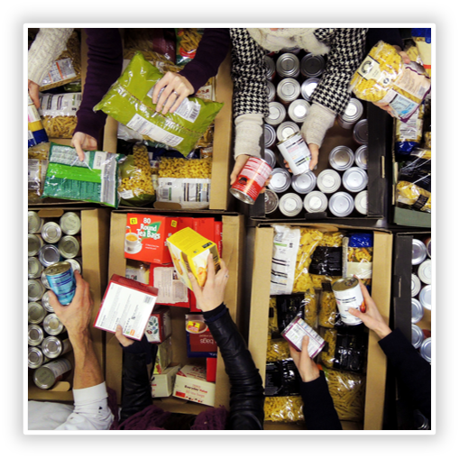
Salisbury Food bank
Providing practical support to local people & working alongside other food banks to build a future where everyone has enough money for essentials
Notes:
Salisbury Foodbank is part of the Trussell Trust network of 426 foodbanks in the UK.

Slide 2
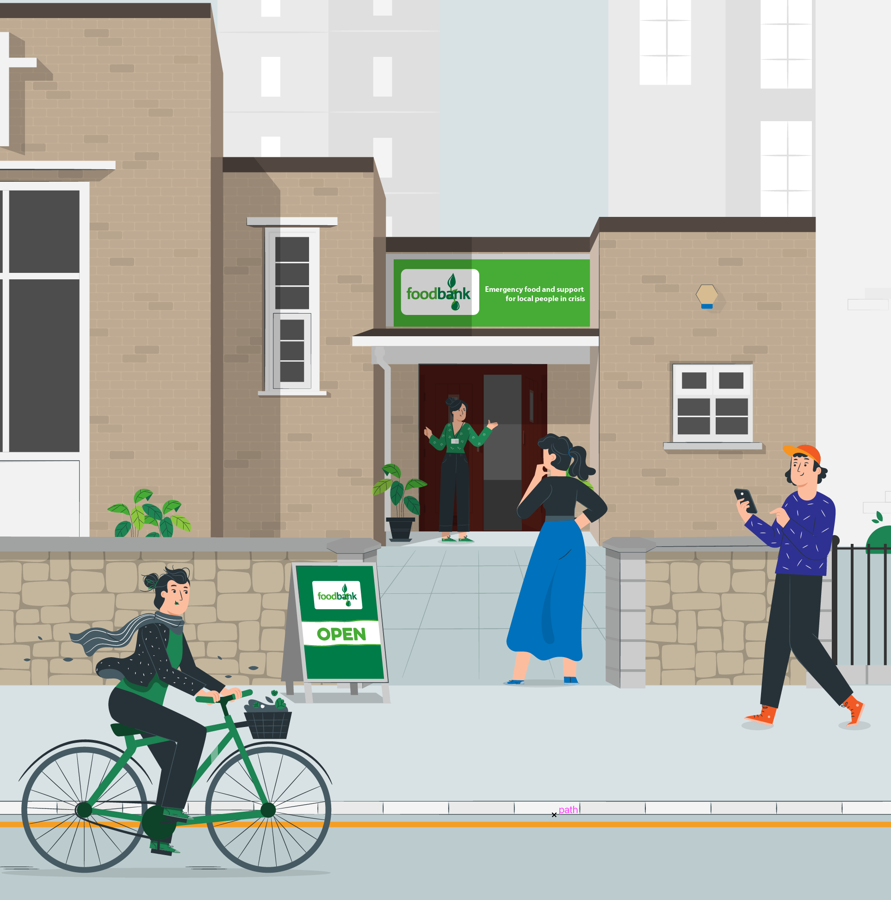
About our food bank
We provide emergency support to local people who don’t have enough money for essentials
We help connect people with additional support to address the reasons why there isn’t enough money coming in
We bring together experiences and evidence from our food bank with what other food banks across the Trussell Trust network are seeing, so we can push for change
Notes:
At our food bank:
Last year we distributed 7191 emergency food parcels to local people who didn’t have enough money for essentials - these parcels are made from food and essentials generously donated by community and church groups, schools, local businesses and kind individuals.
Our 100 volunteers collected, weighed and packed food donations, and provided a safe, welcoming and friendly place where people can come to talk, be listened to, supported, and even offered a shoulder to cry on.
We work with over 100 different local organisations and agencies across the area, so our volunteers are able to signpost people onto additional support to help address the reason why someone has been left without enough money for the essentials
If you offer additional support: We connected people who needed our food bank with wraparound support and advice, for example to help people access the social security support they’re entitled to. This connection with wider wraparound support and the unlocking of crucial social security payments puts money directly into people’s pockets and makes it far less likely someone will need to use a food bank in the future.
We bring together experiences and evidence from our food bank with what other food banks across the Trussell Trust network are seeing, and share what we know to push for longer-term change.
You might want to give some examples of the way you work with different groups locally and the areas you cover locally.

Slide 3
“I was working as a secretary and a cleaner, and I am a mum. I was diagnosed with breast cancer, advanced stage.
After treatment, I had chronic fatigue syndrome, no money and bills were rising up”
Lucille
Notes:
Now I’ve shared a bit about how we work locally, I want to focus on why our work is needed and who we’re helping.
This is from Lucille, who needed to use a food bank during the pandemic. She wasn’t able to work because of her health, after an advanced stage cancer diagnosis and chronic fatigue after treatment, and there wasn’t enough money coming in for the essentials.

Slide 4
“Without the support of the food bank during the pandemic, I would have had to choose between food and a shower, and clean teeth and clean laundry to wear.”
Lucille
Notes:
When people don't have enough money coming in for the essentials, they're faced with impossible decisions – as Lucille makes so clear here. Can you imagine what it would feel like to be faced with that kind of decision?
Every week we meet people in positions like Lucille’s – local people who are hit by something unexpected, don’t get the right support at the right time, and then are left facing impossible decisions because there isn’t enough money coming in for the things we all need.
I’m really glad to share that the odds for Lucille recovering from cancer are now better and she feels she has a brighter future. But someone in Lucille’s position should never have been forced to use a food bank in the first place.
And unfortunately Lucille isn’t alone.

Slide 5
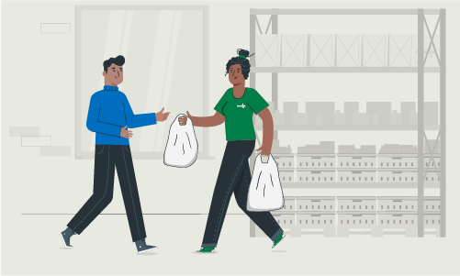
People needing the food bank locally
2022
7191
emergency food parcels provided to local people.
36%
went to children
85%
increase in the last five years
Notes:
From during 2022, 7191 many emergency parcels to people in Salisbury and the surrounding areas. 36% of these were provided for children.
That’s a 85% increase in the last 5 years. It’s 7191 parcels too many.

Slide 6
We should all be free from hunger
Notes:
It’s not right that people in our community are needing a charity’s help to put food on the table. Everyone in [insert area] should have enough money for the things we all need.
We should all be free from hunger, but more and more people are struggling without enough money for the things we all need and have no option but to use a food bank.
Hunger in the UK isn’t about food – it’s about not having enough money coming in for the essentials. People at food banks have the lowest incomes in the country.
On average, people in households which need a food bank have less than £60 a week to live on, after paying for housing. That’s around 13% of the average household income in the UK. It’s not enough for the essentials we all need, let alone a decent standard of living.
At the same time, we’re seeing huge increases in how much money we all need to cover the cost of living. We already saw people at food banks last winter who were having to make impossible decisions between heating and eating. With energy prices, food bills, fuel costs and more all set to soar as the temperatures drop this winter, the cost of surviving will be too high.

Slide 7
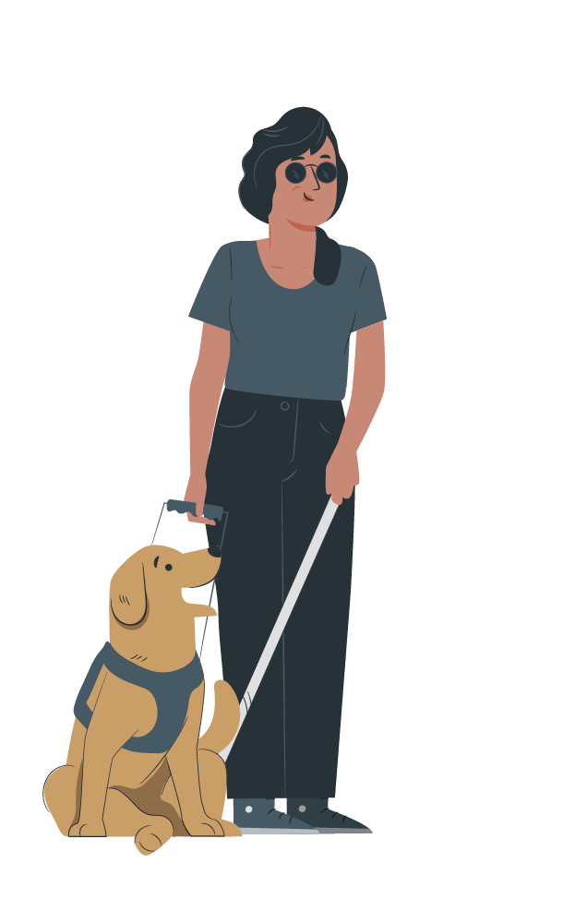
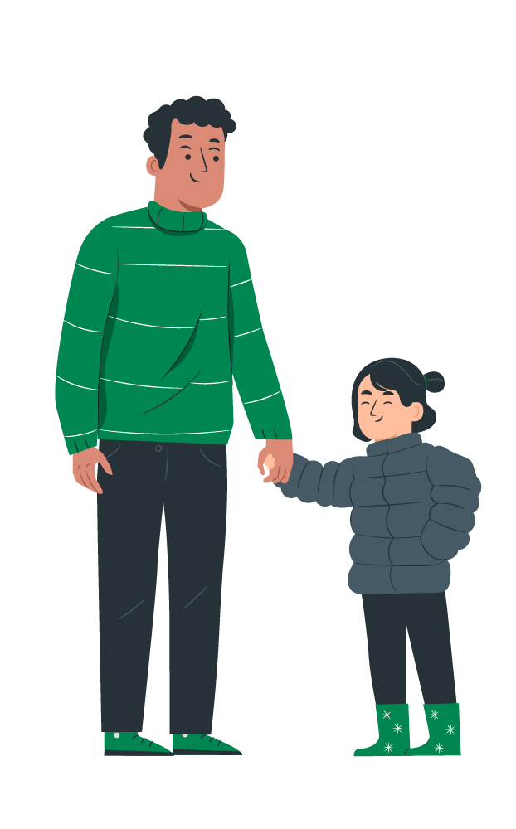
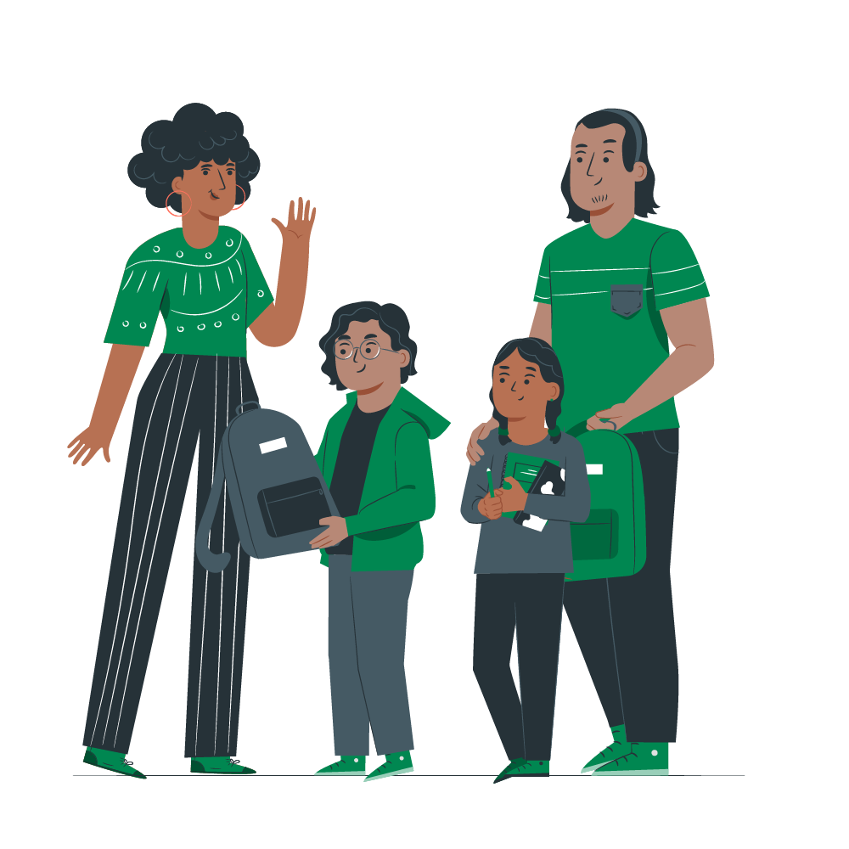
Who needs our food bank and why are their incomes so low?
Single parents
Disabled people and people with health problems
People needing to care for children or relatives that aren’t well
Notes:
Why are people’s incomes so low?
The incomes of people at food banks are so low for two reasons: either their work isn’t well-paid or secure, or they can’t work and aren’t getting enough support to ensure there’s enough money to live on.
Most people who’ve needed to use a food bank are likely to face barriers to well-paid secure employment or support, often at the same time as having higher living costs.
Three quarters of people referred to a food bank report that at least one person in their household has a mental health problem
6 in 10 people are disabled
Many people who need food banks have to care for children or for relatives who aren’t well
Around a third of households referred to food banks who didn’t have anyone currently working, did previously have someone employed in the last year.
Because people’s incomes are already so low, when someone is hit by something outside of their control - like the loss of a loved one, an illness or a boiler breaking - they don’t have enough money to act as a buffer and they’re tipped over the edge.
Not everyone is able to fall back on friends or family - they might not have enough money themselves. That’s why we expect our social security system to support anyone who isn’t able to work, faces barriers to finding secure well-paid work, or is between jobs. But right now our social security system is not a strong enough lifeline. It does not provide enough money for people to live with dignity, and all too often the way it works makes life harder for people whose lives are already hard enough.

Slide 8
Together we can change this
There’ll always be a role for strong community groups looking out for their neighbours. But it isn’t right that people don’t have enough money for the essentials.
We need to change this.
Notes:
There’ll always be a role for strong community groups looking out for their neighbours, but it isn’t right that people don’t have enough money for the essentials. People on the lowest incomes need to have enough money coming in to meet the increasing cost of living.
Alongside other food banks in the Trussell Trust’s network, we know what is pushing people to need food banks, so we know we can build a future where everyone has enough money to live on if we make sure:
There are changes to social security support, so payment levels ensure everyone can afford the essentials, and the system is able to get money to people at the point when support is needed
Emergency support from local authorities is able to prevent someone facing a short-term crisis, like a boiler breaking, from being pulled deeper into poverty in the long-term
People with experience of financial hardship are shaping and directing the change needed at all levels.

Slide 9
Local people, supporting local people
You can help by:
Donating food
Donating money
Spreading the word about what we’re seeing
Notes:
That’s where you come in!
We’re only able to do what we do because of the generous support of the local community – most of the food we provide is donated, and we wouldn’t be able to do anything with those donations if we didn’t have such a dedicated team of volunteers.
We’re local people, supporting local people, and we’d be so grateful for your support.
You can help by:
Donating food – Tinned Soup, fruit, potatoes, rice pudding & meat. Long life Milk and Fruit juice. Bars of Chocolate and sponge pudding food items are particularly needed at the moment, you can donate them by dropping off at Unit 6b Ashfield Trading Estate, SP2 7HL. Mon – Friday 9:30 – 3:00
Donating money – we have essential costs to cover, eg rent/bills etc – any support you give will be gratefully received and used carefully Please make cheques payable to “Salisbury Foodbank” Or donate online via Just giving link on our website: https://salisbury.foodbank.org.uk
Spreading the word about what we’re seeing – if everyone in this room went home and told a friend or family member about what they’ve heard today, there’d be roughly X (double the number in the room!) people who know more about what people at the food bank are facing and how we can change that in the future.

Slide 10
THANK YOU
Insert food bank logo
Notes:
Thank you for listening today – does anyone have any questions?

